Slide 1
Predictive Healthcare Analysis of Elevens Disease Categories
CSCI E-116
Waree Protprommart

Slide 2
Major Outbreak of the 2000s
West Nile Virus
SARS-CoV
E.coli & Salmonella
Whooping Cough
2001
2006
2009
2014
1999-2002
2003
2006
2012
Anthrax
Mumps
H1N1 Virus
Ebola
2020
2016
COVID-19
Zika Virus

Slide 3
Purpose and Significance
Purpose
Arima model
United States data time series analysis of eleven disease categories, including Autoimmune, Bacterial, Cardiovascular, Chronic, Genetic, Infectious, Metabolic, Neurological, Parasitic, Respiratory, and Viral, starting from the year 2000 until 2024
Dynamic panel data model
predict the mortality rate in all disease categories by using the other 18 features
Significance
Efficient allocation of resources and medical staffs
Preventative healthcare

Slide 4
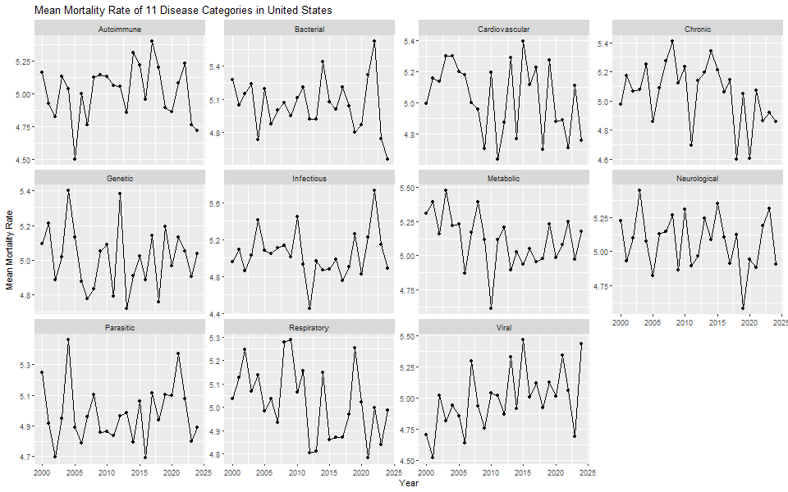
Exploratory Data Analysis
Most disease mortality fluctuating around mean
Figure 1. Mean mortality rate of eleven disease categories from 2000 until 2024.

Slide 5
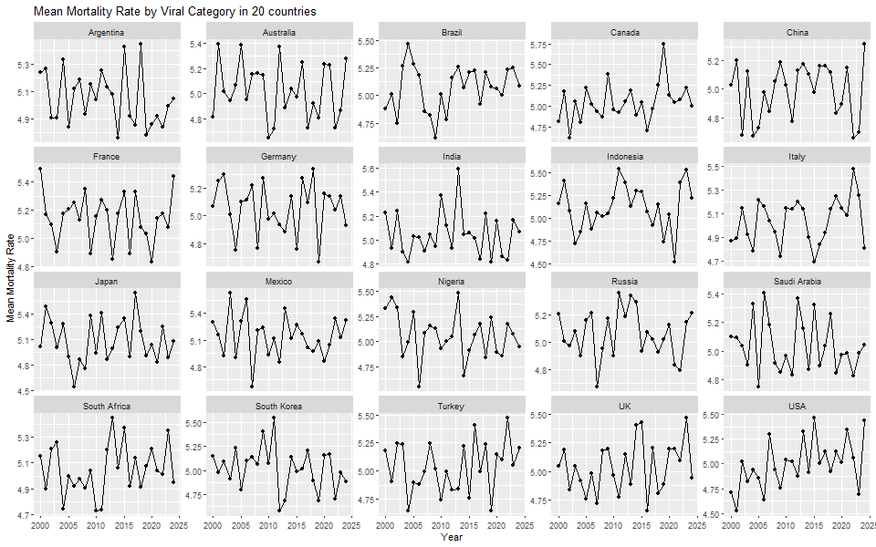
Exploratory Data Analysis
The mortality rate of a particular disease trend observed in the United States does not translate to the same observation for the rest of the world.
Figure 2. Mean mortality rate by cardiovascular and viral disease amongst twenty countries from 2000 until 2024. More disease categories are available in the appendix.

Slide 6
ARIMA Model
P
Q
(0,0,0)
Autoregressive term
Moving average term
Autoimmune disease
Bacterial disease
Metabolic disease
Parasitic disease
Respiratory disease
Chronic disease (1,0,0)
Genetic disease (1,0,0)
Infectious disease (2,0,0)
Cardiovascular disease (0,0,2)
Neurological disease (0,0,1)
Viral disease (0,0,2)

Slide 7
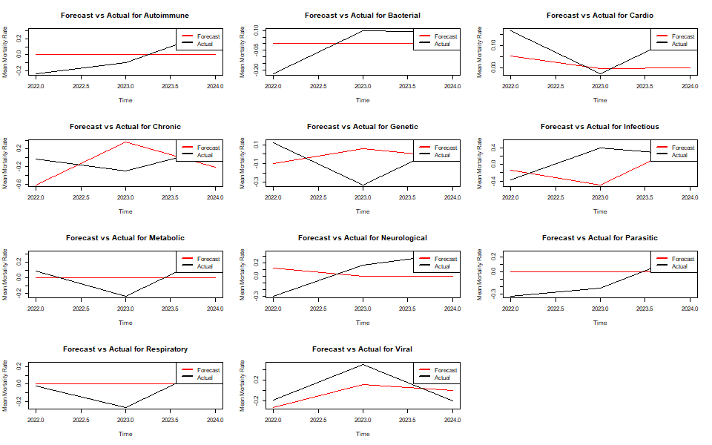
Out of Sample Validation
Disease Category | RMSE values
Cardiovascular | 0.12
Bacterial | 0.15
Respiratory | 0.20
Autoimmune | 0.23
Metabolic | 0.23
Viral | 0.27
Genetic | 0.27
Parasitic | 0.27
Neurological | 0.33
Chronic | 0.56
Infectious | 0.56
Figure 3. Plot of forecast (red line) vs actual(black line) values of the mean mortality for each disease category.

Slide 8
Dynamic Panel Data Model
mean_mortality = lag(mean_mortality) + mean_prevalence + mean_income +
mean_incidence + mean_healthcare + mean_doc_per1000 + mean_treatment_cost + mean_hos_per1000 + mean_treatment_cost + mean_recovery + mean_DALYs + mean_imp_5_yrs + mean_urban
Categorical: Country and Disease Category
Random model
Between model
Fixed effect model
Coefficients:
Estimate Std. Error t-value Pr(>|t|)
(Intercept) 1.2807e-01 1.9953e+00 0.0642 0.95062
lag(mean_mortality) 7.5577e-01 7.5780e-02 9.9733 2.178e-05 ***
mean_income 2.3668e-05 8.2639e-06 2.8640 0.02420 *
mean_recovery -3.8895e-02 1.3660e-02 -2.8473 0.02478 *
mean_urban 2.9140e-02 1.2767e-02 2.2825 0.05643 .
---
Signif. codes: 0 ‘***’ 0.001 ‘**’ 0.01 ‘*’ 0.05 ‘.’ 0.1 ‘ ’ 1
Total Sum of Squares: 0.0050897
Residual Sum of Squares: 9.3193e-05
R-Squared: 0.98169
Adj. R-Squared: 0.9503
F-statistic: 31.2749 on 12 and 7 DF, p-value: 6.6087e-05
Coefficients:
Estimate Std. Error z-value Pr(>|z|)
(Intercept) 4.3657e+00 4.5710e-01 9.5508 <2e-16 ***
---
Signif. codes: 0 ‘***’ 0.001 ‘**’ 0.01 ‘*’ 0.05 ‘.’ 0.1 ‘ ’ 1
Total Sum of Squares: 158.42
Residual Sum of Squares: 157.82
R-Squared: 0.0037996
Adj. R-Squared: 0.00039082
Chisq: 13.3758 on 12 DF, p-value: 0.34232
Coefficients:
None of them are statistically significance
Total Sum of Squares: 157.53
Residual Sum of Squares: 156.94
R-Squared: 0.0037225
Adj. R-Squared: -0.005132
F-statistic: 1.08605 on 12 and 3488 DF, p-value: 0.36709

Slide 9
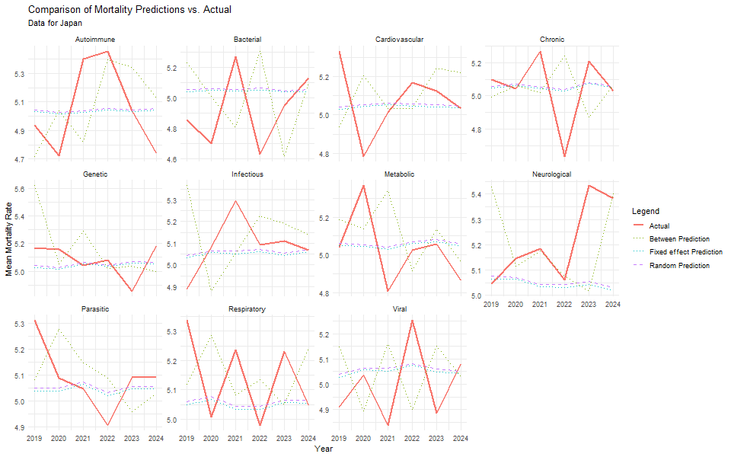
Out of Sample Validation
Models | RMSE values
Between | 0.140
Random | 0.22
Fixed Effects | 0.22
Figure 5. Facet grid plots of the comparison between predictions vs actual mean mortality in each disease category of Japanese dataset.

Slide 10
Conclusion
United States Disease Mortality
A lot of disease categories cannot be model by ARIMA
Random, White noise behavior
Among those that can be model, Cardiovascular disease shows the most promising result based on out of sample validation
International and External Variables Impact on Disease Mortality
Random and Fixed effect models:
There are no significant effects of the external factors and past lag of the data itself on the mean mortality rate.
Between model
the first lag of mean mortality rate, mean income, mean urbanization rate and mean recovery rate of the between models are statistically significant
best performer in predicting mortality rate

